Slide 1
VG101 Jigang RC7
Wang, Kaibin

Slide 2
C Language – Type and Variable Declaration
C is a Strong-type language (in comparison to Matlab).
Type in C:
Integer: int
Floating point: float & double
Character: char
User-defined types/Composition types (such as structs, pointers and arrays)
Variable Definition: Type name;
Undeclared variable will cause an error in C!!

Slide 3
C Language – Grammar Specifications
‘;’ is the only end sign of a sentence. E.g.
int
a
=
0; //This is a valid C sentence
Block of program: Noted by {}, it also determines the scope of variable
Control sentences: control() {}, including if, while, for and switch

Slide 4
C Language – Boolean and if/while
C does not have a single Boolean/Logical value type, but all other type can represent a boolean value.
If the value tends to be all zero in memory, it will act as ‘false’ or it will be ‘true’.
stdbool.h defines Boolean types (not usually used)
Logical operations in C:
Equal: == (= is also an operator in C, so a = b = c is valid, and if(a = 1) is also valid but it may cause some bugs)
Comparison: >, <, >=, <=, !=
Operators: ! (not), ||, &&
If and while sentence requires: if/while(Boolean) {}, to run the block if the Boolean is ‘true’.

Slide 5
C Language – for loop
Syntax: for(initialization;condition;loop operation) {}
It’s equal to:
initialization;
while(condition) {
…
loop operation;
}
For loop is the most massively used loop in C Language.

Slide 6
C Language – Function Declaration
Syntax:
return_type name(argument_specification);
In the case that no return value exist? Use void as the return_type
Separate the declaration and realization:
return_type name(argument_specification); // Declaration
int main() {} // Some functions
return_type name(argument_specification) { // Realization
}
Why? Procedure abstraction.

Slide 7
C Language – Syntactic Sugar
C provides some syntactic sugar to make our code more compact.
Self-operation: +=,-=…, ++, -- The operation that is made to the variable itself
Example usage: arr[size++] = val; // Push stack
Ternary operator: Boolean?a:b; returns a if Boolean is true, if not, return b
Example usage: maxval = a>b?a:b;
‘=‘ operator: returns the both sides while making the assign process
Example usage: while((c = getchar()) != ‘\n’) {}

Slide 8
C Language – Scoping and Life Period
In C language, the scope of variable is determined by block.
When the variable is out of scope, the memory it occupies will be freed. This results in the life period of a variable.
E.g.
int main() {
int *p;
{
int arr[] = {1, 2, 3, 4};
p = arr;
}
int arr2[] = {3, 4, 5, 6};
printf("%d", p[1]); // Will this print 2? (Actually the result varies in different compilers, in GCC, it’s 4)
return 0;
}

Slide 9
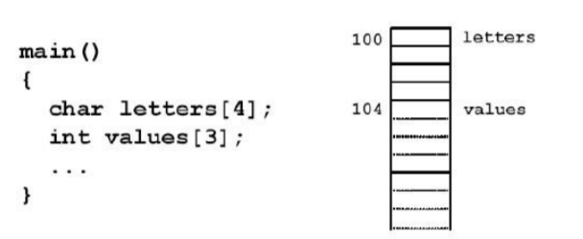
C Language – Array and Memory Management
In C Language, array is a data structure with continuous memory distribution.
Syntax: type arr[MAXCOUNT] = {List Initialization};
Jigang, Lecture 12

Slide 10
C Language – Array and Memory Management
The array variable is actually the pointer that points to the first element.
We can see that the array doesn’t contain information of its length, so to read the length of an array is impossible.
To pass an array to a function, it’s actually passed by pointer. The change to the array in the function will cause to original array to be changed.
Example.

Slide 11
C Language – Array and Memory Management
#include <stdio.h>
void foo(int arr[]);
int main() {
int arr[] = {1, 2, 3, 4};
foo(arr);
printf("%d\n", arr[0]); // What will it print?
return 0;
}
void foo(int arr[]) {
arr[0] = 2;
}

Slide 12
C Language – Array and Memory Management
Use this feature to simulate multi return values.
See example in WSL…

Slide 13
C Language – Array and Memory Management
What if the indexing of array exceeds boundary?
See examples in WSL…

Slide 14
C Language – Array and Memory Management
What if we initialize a huge array in a function? – Stack Overflow.
int main() {
int arr[3879731] = {0};
return 0;
}

Slide 15
C Language – Array and Data Structures
Array can construct the simplest data structure – linear structure. The representatives are list, stack and queue. In this RC, I will introduce stack and queue to you.

Slide 16
Stack and Recursive Structure
Stack is a so-called LIFO (Last In First Out) structure.
There are two operations of a stack,
Push stack: Add an element to the top of the stack
Pop: Pop the top-most element and get its value.
How to realize a stack in C language?
int stack[MAX_ELTS], top = 0; // This top is called stack-top pointer
stack[top++] = elt; // Push stack
elt = stack[--top]; // Pop

Slide 17
Stack and Recursive Structure
The actions in a linear recursive structure(a function call itself once a time) an be abstracted to a stack. Each function call is a push and each return is a pop.
So we can change linear recursive structure to iterative structure using stack structure.
while(!end_condition) {
do some operations…
push_stack(result1);
}
while(top != 0) {
elt1 = pop_stack();
arg = pop_stack();
do some operations…
push_stack(result2);
}
Fun(arg) {
do some operations…
elt1 = fun(result1);
do some operations…
return result2;
}

Slide 18
Stack and Recursive Structure
A concrete example: partial sum problem.
Given a set of numbers L, and a number a. Find a combination of elements in L whose sum is a. If there are multiple combinations, print the best combination, which satisfies:
The amount of numbers in the combination is the smallest.
The largest number of the combination is the smallest.
Inputs: n a L1 L2 … (n is the count of number in L, n < 10), assume L is sorted and assume the size of combination is smaller than 100.

Slide 19
Stack and Recursive Structure
How to solve? Search all possible combinations.
See sample code in WSL…

Slide 20
Stack and Recursive Structure
This algorithm is called DFS (depth first search), we will have lab question about this algorithm.
However, DFS may fail, if the complexity is too high.

Slide 21
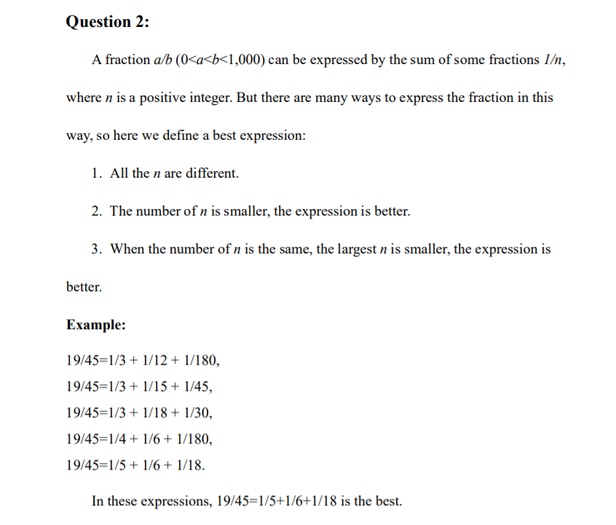
Stack and Recursive Structure
A concrete example: How to calculate Egyptian fraction? (Lab5 Question2 of FA18)

Slide 22
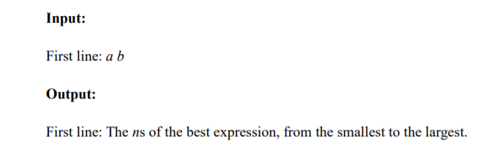

Slide 23
Stack and Recursive Structure
How to calculate? An intuitive idea: DFS.
How to determine the end point for each layer? Pass the best value
19/45
1/3
1/4
1/5
1/12
1/15
1/18
1/6
1/6

Slide 24
Stack and Recursive Structure
Sample Code in WSL..

Slide 25
Stack and Recursive Structure
A testcase that fails: 993 997.
How to solve this bug? We could combine it with BFS, we will talk about later in this RC.

Slide 26
Stack and Recursive Structure
Some more applications:
Reverse Polish Expression
Function Stack (to design a compiler)
List and other linear recursive structures

Slide 27
Queue and BFS
Different from stack, queue is a FIFO data structure, i.e. First In First Out.
There are two operations of a queue,
Enqueue: Add an element to the top of the queue
Dequeue: Pop the last element and get its value.
How to realize a queue in C language? (Especially the dequeue process)
Move each element in the dequeue process (time consuming).
Move the header pointer in the dequeue process (space consuming).
Use linked list (discrete distribution of memory).

Slide 28
Queue and BFS
Boarder expansion and Queue.
 | a | b | c | d
1
2
3
4
5
6
Target: b3
Border: b3

Slide 29
Queue and BFS
Boarder expansion and Queue.
 | a | b | c | d
1
2
3
4
5
6
Target: b3 b2 c3 b4
Border: b3 b2 c3 b4

Slide 30
Queue and BFS
Boarder expansion and Queue.
 | a | b | c | d
1
2
3
4
5
6
Target: b3 b2 c3 b4 c2
Border: b3 b2 c3 b4 c2

Slide 31
Queue and BFS
Boarder expansion and Queue.
 | a | b | c | d
1
2
3
4
5
6
Target: b3 b2 c3 b4 c2
Border: b3 b2 c3 b4 c2

Slide 32
Queue and BFS
Boarder expansion and Queue.
 | a | b | c | d
1
2
3
4
5
6
Target: b3 b2 c3 b4 c2 b5
Border: b3 b2 c3 b4 c2 b5

Slide 33
Queue and BFS
Boarder expansion and Queue.
 | a | b | c | d
1
2
3
4
5
6
Target: b3 b2 c3 b4 c2 b5
Border: b3 b2 c3 b4 c2 b5

Slide 34
Queue and BFS
How to use this to implement our lab3?
Sample Code in WSL…

Slide 35
Implement a library of Queue in C
We could see that a queue structure is more complex than stack, and we could not use just one sentence to accomplish the operations of Queue.
So we can write a library and use it in our program.
See codes in WSL…

Slide 36
BFS and DFS, Iterative DFS
We see that pure DFS fails in calculation some Egyptian fraction, we could integrate it with BFS and get a improved algorithm called Iterative DFS.
How is it implemented? We fix the recursive layer depth and do DFS for this layer.
See sample codes in WSL…

Slide 37
Thanks for listening
My OH will start soon

